Slide 1
$$σn = σn\left(n, x, t\right)$$
n′
→
n
→
ω
Δx = v Δt, Δn = [ω×n ] Δt,
Δx_{i} = v_{i} Δt,
Δn_{i} = ε_{ijk}ω_{j}n_{k} Δt
→
→
→
→
n
→
→
Δx
→

Slide 2


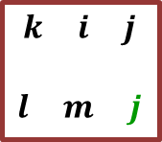
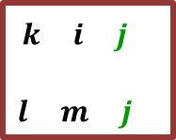
$$\begin{matrix}k i j \\ \\ l m j\end{matrix}$$
$$\begin{matrix}k i j \\ \\ l m j\end{matrix}$$
Δx = v Δt, Δn = [ω×n ] Δ t,
Δx_{i} = v_{i} Δt
ε_{ijk}ε_{lmk} ≡ ε_{kij}ε_{klm} = δ_{il} δ_{jm} – δ_{im}δ_{jl}
Δn_{i} = ε_{ijk}ω_{j}n_{k} Δt = ε_{ijk} ω_{j}n_{k} Δt = ε_{ijk} (¹/₂ rot v)_{j} n_{k} Δt
= ¹/₂ Δt n_{k} ε_{ijk} (ε_{jlm}∇_{l} v_{m})
= ¹/₂ Δt n_{k} ε_{jki} ε_{jlm}∇_{l} v_{m}
= ¹/₂ Δt n_{k} (δ_{kl} δ_{im} − δ_{km} δ_{il} )∇_{l} v_{m} =
= ¹/₂ Δt n_{k} (δ_{kl} δ_{im}∇_{l} v_{m} − δ_{km} δ_{il} ∇_{l} v_{m} ) = Δt n_{k} (∇_{k} v_{i} − ∇_{i}v_{k} ) ¹/₂ =
= Δt n_{k} ω_{ik}
$$ω_{ik}=\frac{1}{2}\left(\frac{∂{\text{v}}_{i}}{∂x_{k}​}−\frac{∂{\text{v}}_{k}}{∂x_{i}​}\right)$$
$$σ_{n}=n_{1}σ_{1}+n_{2}σ_{2}+n_{3}σ_{3}=σ_{q}n_{q}$$
→
→
→
→
→
- Equilibrium Equation of Surface Forces at the point

Slide 3

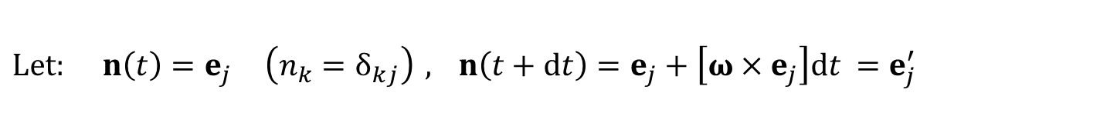

e′_{j}
e_{j}
→
→
$$ω_{ik}=\frac{1}{2}\left(\frac{∂{\text{v}}_{i}}{∂x_{k}​}−\frac{∂{\text{v}}_{k}}{∂x_{i}​}\right)$$
$Let: n\left(t\right)=e_{j} \left(n_{k}=δ_{kj}\right) , n\left(t+dt\right)=e_{j}+\left[ω×e_{j}\right]​dt$ $=e_{j}^{′}$
$$σ_{n}=σ_{j}$$
→
→

Slide 4
dx = v dt (dx_{i} = v_{i} dt)
dn = [ω×n ] dt (dn_{i} = dt n_{k} ω_{ik})
dμ = [ω×μ ] dt (dμ_{i} = dt μ_{k} ω_{ik})
dn_{i} = ε_{ijk}ω_{j}n_{k} dt = n_{k} ω_{ik} dt
dμ_{i} = ε_{ijk}ω_{j}μ_{k} dt = μ_{k} ω_{ik}dt
n and μ move and rotate as rigid body (v and ω)

Slide 5
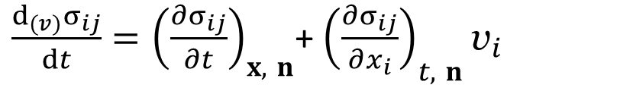
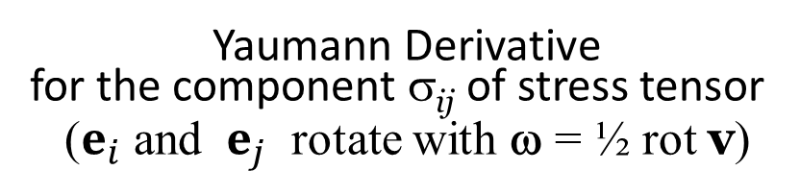
Let
Then
Yaumann Derivative
for the component σ_{ij} of stress tensor
($e_{i}$ and ${ e}_{j}$ rotate with ω = ½ rot v)
$\frac{d_{(v)}σ_{ij}}{dt}={\left(\frac{∂σ_{ij}}{∂t}\right)}_{x, n}$+ ${\left(\frac{∂σ_{ij}}{∂x_{i}}\right)}_{t, n}{\text{v}}_{i}$

Slide 6
INTEGRAL, DIFFERENTIAL, AND JUMP EQUATIONS DERIVED FROM CONSERVATION LAWS

Slide 7
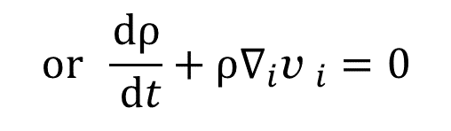
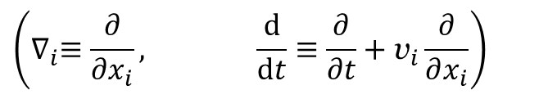
$$\text{or} \frac{dρ}{ dt}+ρ∇_{i}{\text{v} }_{i}=0$$
MOMENTUN CONSERVATION EQUATION
$$\left(∇_{i}≡\frac{∂}{∂x_{i}}, \frac{d}{dt}≡\frac{∂}{∂t}+{\text{v}}_{i}\frac{∂}{∂x_{i}}\right)$$

Slide 8
The time derivative of a volume integral
S(t + Δt)
δV = (Δx ⋅ n) dS (Δx ⋅ n ≡ δ_{n}),
n(t)
M
M′
M
M′
n(t+Δt)
- rate of surface displacement along the outward normal
δ_{n} < 0
δ_{n} > 0
S(t)

Slide 9
Two types of control volume in a continuous medium: Eulerian and Lagrangian
1. Eulerian: V_{E} = const, S_{E} = const, N = 0
Integration and time differentiation operators are commutative
2. Lagrangian: V_{L} = V_{L}(t), S_{L} = S_{L}(t), N = v ⋅ n ≡ v_{n}.

Slide 10
Let S(t) defined by the equation
ψ(x₁, x₂, x₃, t) = 0.
It is possible to choose the sign for ± ψ(x₁, x₂, x₃, t) so that values of ψ at points outside V(t) are greater than those at points lying on S(t) .
Then the outward unit normal vector to S(t) :
For your homework
ψ(x + Δx, t + Δt) – ψ(x, t) =
ψ(x₁ + Δx₁, x₂ + Δx₂, x₃ + Δx₃, t + Δt) – ψ(x₁, x₂, x₃, t) =
(x + n δ_{n}, t + Δt) ≡ (x₁ + n₁δ_{n}, x₁ + n₂δ_{n}, x₃ + n₃δ_{n}, t + Δt) ∈ S(t + Δt).
ψ(x, t) ≡ ψ(x₁, x₂, x₃, t) = 0,
ψ(x + n δ_{n}, t + Δt) ≡ ψ(x₁ + n₁δ_{n}, x₁ + n₂δ_{n}, x₃ + n₃δ_{n}, t + Δt) = 0,

Slide 12
Transformation of a surface integral into the volume integral of a divergence
dS
S
δV^{(k)}
V

Slide 13
For any
A = A_{i} e_{i}
A_{i} may be considered as velocity field
v = v_{i} e_{i}
Theorem 2 (Gauss–Ostrogradsky­).

Slide 15
Zero integrand theorem
Theorem 3 (zero integrand theorem).
a continuous function Φ(x, t) defined on a domain V is such that,
for any subdomain ΔV in V,
then
Φ = 0 throughout the domain V.

Slide 16
Integral and Differential Mass Balance Equations
Mass Conservation Equation (for Eulerian Volume)
for any control volume V_{E}
For continuously differentiable ρ(x, t) and v(x, t)

Slide 17
Mass Conservation Equation (for Lagrangian Volume)
For continuously differentiable ρ(x, t) and v(x, t)
for any control volume V_{E}

Slide 18
For continuously differentiable f(x, t) and v(x, t)
0

Slide 19
Integral and Differential Momentum Equation
Momentum Conservation Equation
(for Eulerian Volume)
For continuously differentiable ρ(x, t) and v(x, t)
0

Slide 21
- vis vita equation

Slide 22
Integral and Differential Angular Momentum Equations
∇_{k} x = ∇_{k} (x_{i} e_{i}) = e_{i} ∇_{k} x_{i} = e_{i} δ_{ki} = e_{k}
Angular Momentum
Conservation Eq.
(for Eulerian Volume)
For continuously differentiable ρ(x, t) and v(x, t), u(x, t) and σ(x, t), and q(x, t),
[(∇_{k} x) × v] ρ v_{k} +
+ [x × ∇_{k} (ρ v_{k} v )]
[∇_{k} x × σ_{k}] +
+ [x × ∇_{k}σ_{k}]
[(∇_{k} x) × v] ρv_{k} =
- [e_{k} × v] ρv_{k} =
= [v_{k} e_{k} × v] ρ =
= [v × v] ρ = 0,
[∇_{k} x × σ_{k}] = [e_{k} × σ_{k}] =
= e_{i} ε_{ilm} (e_{k})_{l} σ_{mk} =
= e_{i} ε_{ilm} δ_{kl} σ_{mk} =
= e_{i} ε_{ikm} σ_{km}
= e_{i} ε_{ikm} σ_{km}
0

Slide 23
= e_{i} ε_{ikm} σ_{km}
= 0
i = 1: σ₃₂ – σ₂₃ = 0,
i = 2: σ₁₃ – σ₃₁ = 0,
i = 3: σ₂₁ – σ₁₂ = 0.
e_{i} ε_{ikm} σ_{km} = 0

Slide 24
Intrinsic angular momentum (spin), surface and body couples (torques)
δx
Micropolar (or Cosserat) media
ΔK = [x^{(М)} × v] ρ ΔV + ρ m ΔV,
ρ m = n I .
М
ω₂ >> ∇_{k} v_{j}, ω₂ >> ω = ¹/₂|rot v|
e_{i} ε_{ikm} σ_{km} = = (σ₃₂ – σ₂₃)e₁ + (σ₁₃ – σ₃₁)e₂ + (σ₂₁ – σ₁₂)e₃

Slide 25

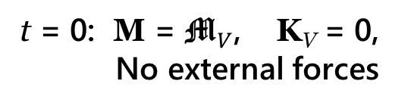

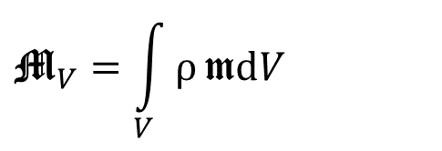
Einstein–de Haas effect
Ferromagnetic rod in Magnetic Field
H
$${\text{M}}_{V}=\int_{V}{ρ}\text{m}dV$$
t = 0: M = ${\text{M}}_{V}$, K_{V} = 0,
No external forces
M = K_{V} + ${\text{M}}_{V}$

Slide 26
Integral and Differential Total Energy Equations
ε = u + ¹/₂ v²
- Specific full energy,
Energy Conservation Equation for a Eulerian Volume
q_{n}
δS
q
n
q_{n} ds = q_{k} n_{k} ds
Usually
M
δr₂
F = g′ + R, g′ = g + a^{(in)}
W^{(ext)} = W^{(u)} + R ⋅ v
δr₁

Slide 27
Energy Conservation Equation for a Lagrangian Volume

Slide 28
Theorem (energy conservation).
The energy within a time-independent domain can be changed by
the energy transfer due to mass transfer across the domain boundary;
the work done by external contact forces on the boundary;
the work done by body (gravitational, electromagnetic, inertial) forces within the domain;
conversion between electromagnetic and internal energy;
heat transfer across the boundary.

Slide 29
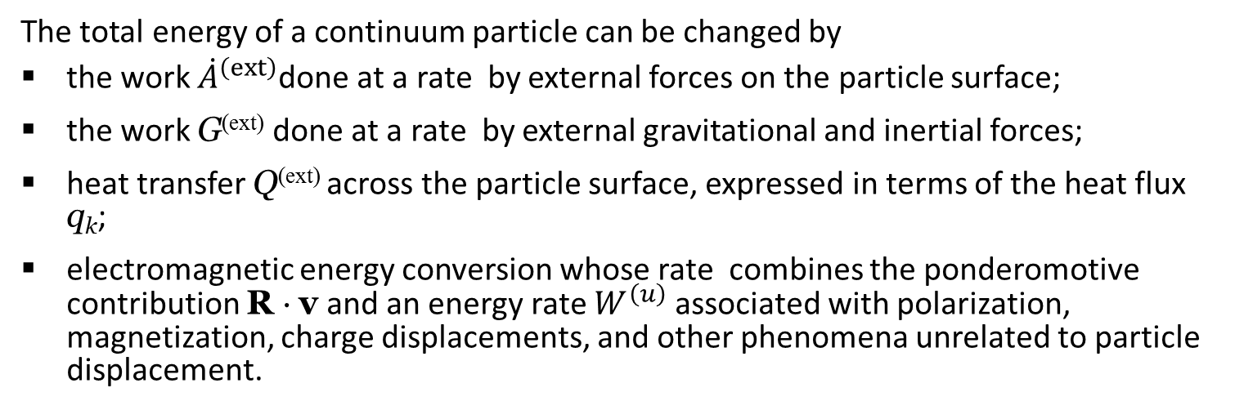
For continuously differentiable ρ(x, t) and v(x, t), u(x, t) and σ(x, t), and q(x, t),
The total energy of a continuum particle can be changed by
the work ${\dot{A}}^{\left(ext\right)}$done at a rate by external forces on the particle surface;
the work G^{(ext)} done at a rate by external gravitational and inertial forces;
heat transfer Q^{(ext)} across the particle surface, expressed in terms of the heat flux q_{k};
electromagnetic energy conversion whose rate combines the ponderomotive contribution R ⋅ v and an energy rate $W^{\left(u\right)}$ associated with polarization, magnetization, charge displacements, and other phenomena unrelated to particle displacement.

Slide 30
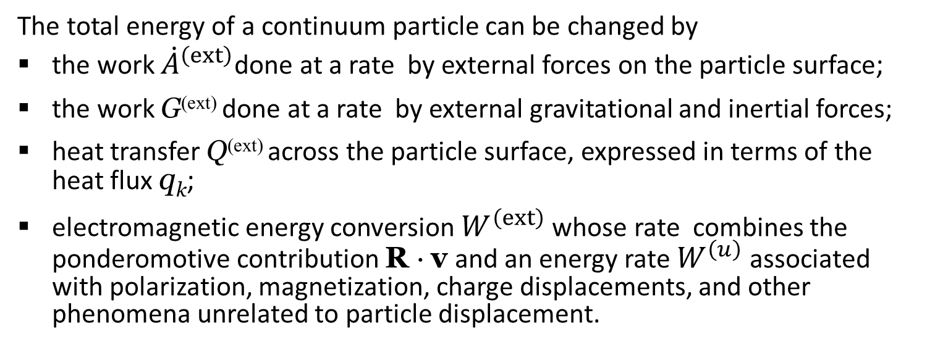
The total energy of a continuum particle can be changed by
the work ${\dot{A}}^{\left(ext\right)}$done at a rate by external forces on the particle surface;
the work G^{(ext)} done at a rate by external gravitational and inertial forces;
heat transfer Q^{(ext)} across the particle surface, expressed in terms of the heat flux q_{k};
electromagnetic energy conversion $W^{\left(ext\right)}$ whose rate combines the ponderomotive contribution R ⋅ v and an energy rate $W^{\left(u\right)}$ associated with polarization, magnetization, charge displacements, and other phenomena unrelated to particle displacement.

Slide 31
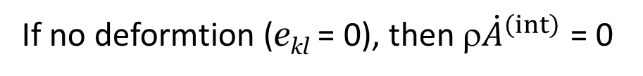
Internal Energy Equation and the First Law of Thermodynamics
- vis vita equation
The first law of thermodynamics.
= σ_{lk} ∇_{k} v_{l} = σ_{kl} ∇_{l} v_{k} = σ_{kl}(∇_{k} v_{l} + ∇_{l} v_{k}) = σ_{kl} e_{kl}
If no deformtion (e_{kl} = 0), then ρ${\dot{A}}^{\left(int\right)}$ = 0
−ρ${\dot{A}}^{\left(int\right)}$ is invariant to Galileo transformation v′ = v + v₀

Slide 33
Differential and Integral Equations for Internal Energy

Slide 34
A Generalized Form of Integral and Differential Balance Equations
Boundary Surface Action
Volume External Action
Volume Internal Action
f | 1 | v | [x × v] | u + ¹/₂ v² | ¹/₂ v² | u
ψ_{k} | 0 | σ^{k} | [x × σ_{k}] | σ_{k}⋅ v − q_{k} | σ_{k}⋅ v | − q_{k}
Ω^{(ext)} | 0 | F | [x × F] | W^{(u)}+ F⋅ v | F⋅ v | W^{(u)}
Ω^{(int)} | 0 | 0 | 0 | 0 | − σ_{kl} e_{kl} | σ_{kl} e_{kl}

